Slide 1
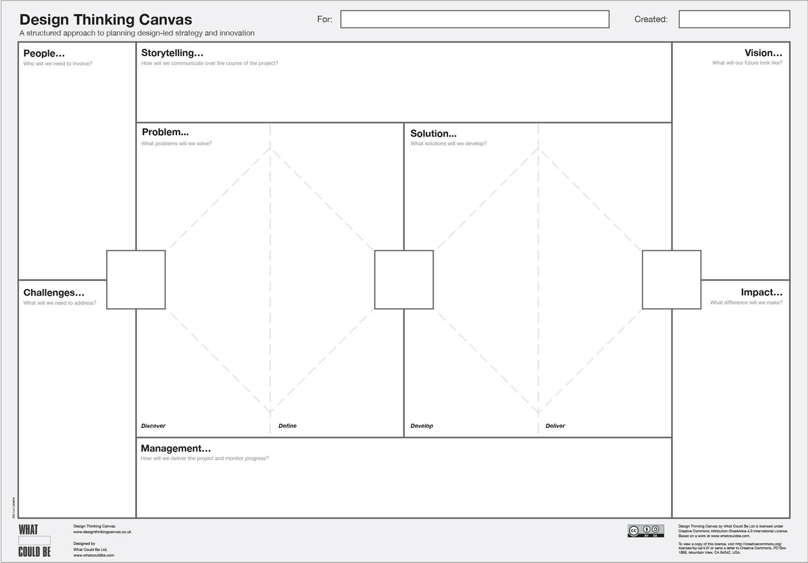
"Our retail brand used to know our customers when they walked through the doors. Now, with thousands of online touchpoints and in-store visits, we struggle to recognize them, much less anticipate their needs. One returning customer told us, 'You remember my name, but forget what I love.' That story pushed us to rethink personalization."
Customers: Expect seamless, personalized experiences
Marketing Teams: Need tools to tailor campaigns and increase engagement
Store Managers: Want to align in-store experience with online profiles
IT/Tech Teams: Responsible for integrating personalization engine
Executives: Focused on ROI, customer retention, and market competitiveness
"Create a seamless, personalized customer journey that makes every interaction feel like a curated experience — from a push notification to a fitting room visit — while empowering teams with real-time insight."
Use Case: AI-Powered Customer Personalization Platform for Retail
Customers receive generic product recommendations and inconsistent experiences across web, app, and in-store touchpoints. Marketing campaigns underperform due to lack of real-time customer insight.
AI-Powered Personalization Platform that:
Consolidates data across all channels (POS, e-commerce, CRM)
Uses machine learning to offer real-time product recommendations
Enables omnichannel personalization (email, web, app, in-store screens)
Includes customer profile dashboards for staff and marketers
🎯 35% increase in customer engagement across digital channels
🛒 20% boost in average order value through personalized suggestions
🔁 Enhanced customer retention and loyalty program participation
⏱️ Faster marketing execution with AI-generated customer segments
✅ Compliance-first design with audit trails and consent management
Data silos: Fragmented customer data across systems
Change resistance: Staff and managers hesitant to adopt new tools
Privacy: Customer consent and GDPR/CCPA compliance
Integration complexity: Tying legacy systems with new AI engine
Marketing Leadership: Champions use of platform for campaigns
Change Manager: Oversees training and adoption effort
Product Owner: Drives AI platform roadmap
Data Science Team: Builds and maintains recommendation models
Engineering Team: Integrates backend and frontend touchpoints

